Slide 1
Chapter 45

Slide 2
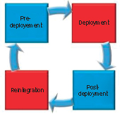
Figure 1 The deployment cycle.

Slide 3
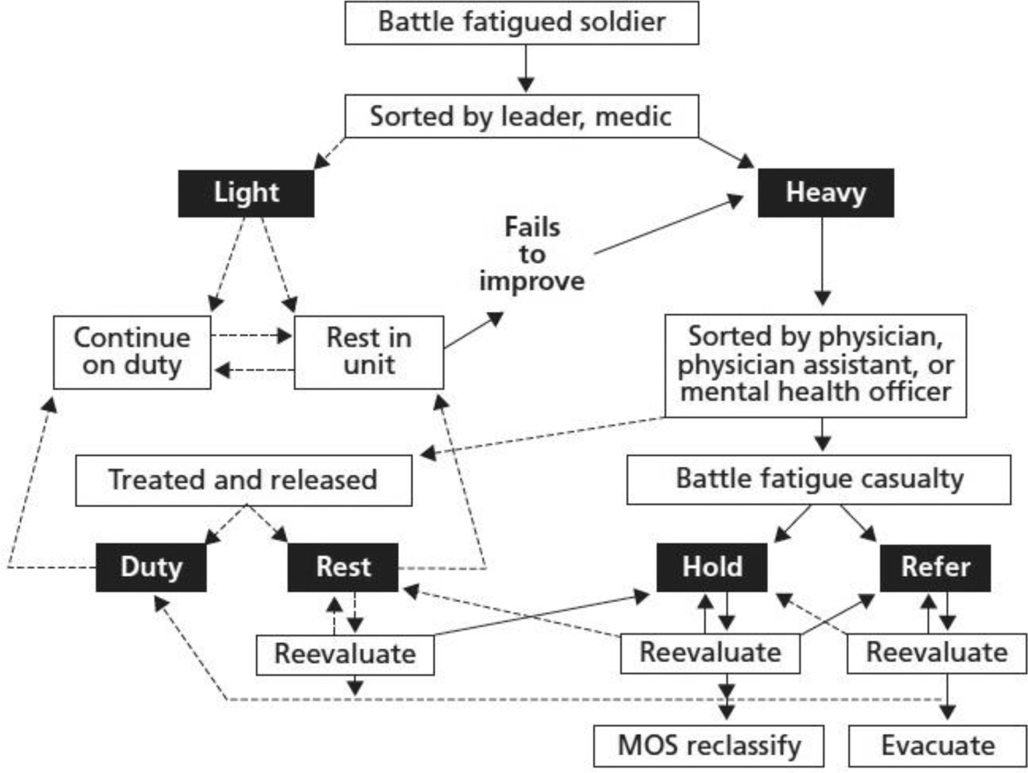
Figure 2 Combat stress triage model.
Reproduced from Helmus TC, Glen RW. Steeling the mind: combat stress reactions and their implications for urban warfare. RAND Center for Military Health Policy Research, http://www.rand.org/pubs/monographs/MG191.html; Published 2005 Accessed 26.04.15.

Slide 4
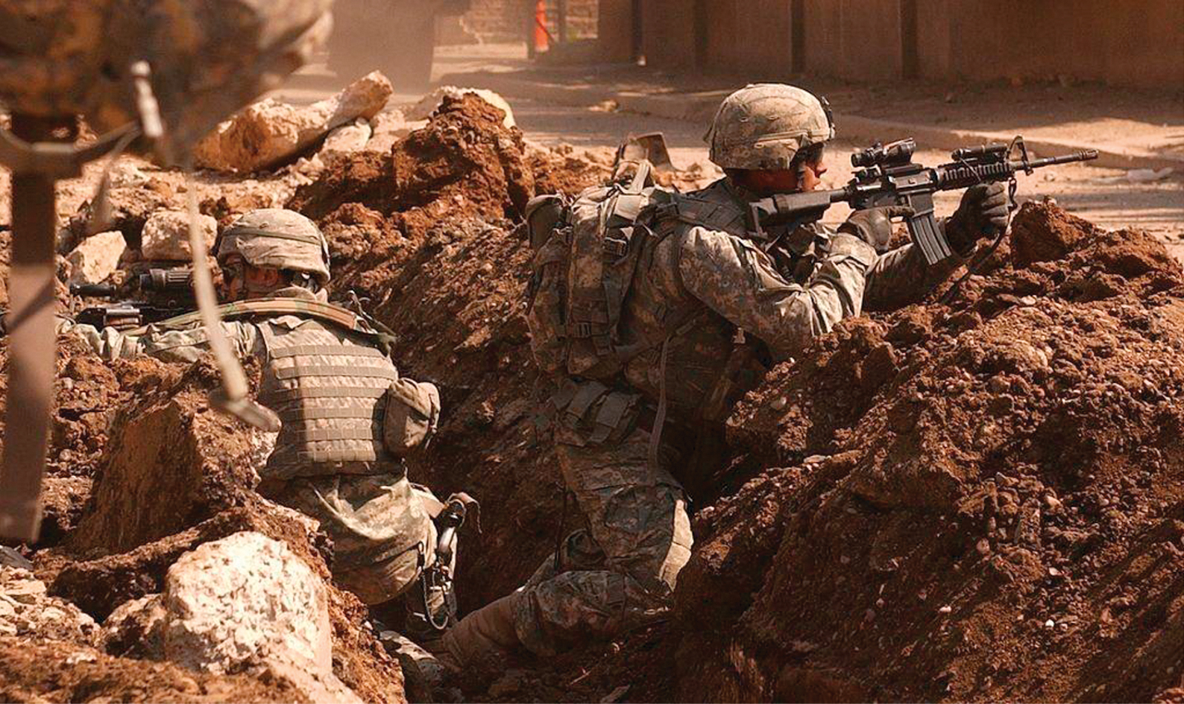
Figure 3 United States Army, 2007. Sgt. Auralie Suarez and Private Brett Mansink take cover during a firefight with guerrilla forces in the Al Doura section of Baghdad on the 7th of March.
Image by Staff Sgt. Sean A Foley, United States Army. http://www.army.mil/images/2007/03/21/3462.

